Slide 1

Big data platform (Spark) performance acceleration
Mentors: Tony Tan, Ning Wu, Yong Wang and Theo Gkountouvas
By:
Grishma Atul Thakkar
Virat Goradia
Nipun Midha
Baoshu Brady Qi

Slide 2

Sprint Goals
Set-up environment
Find the existing spark code
Read and summarize riffle paper
Research about the spark architecture and their phases: map, shuffle and reduce

Slide 3
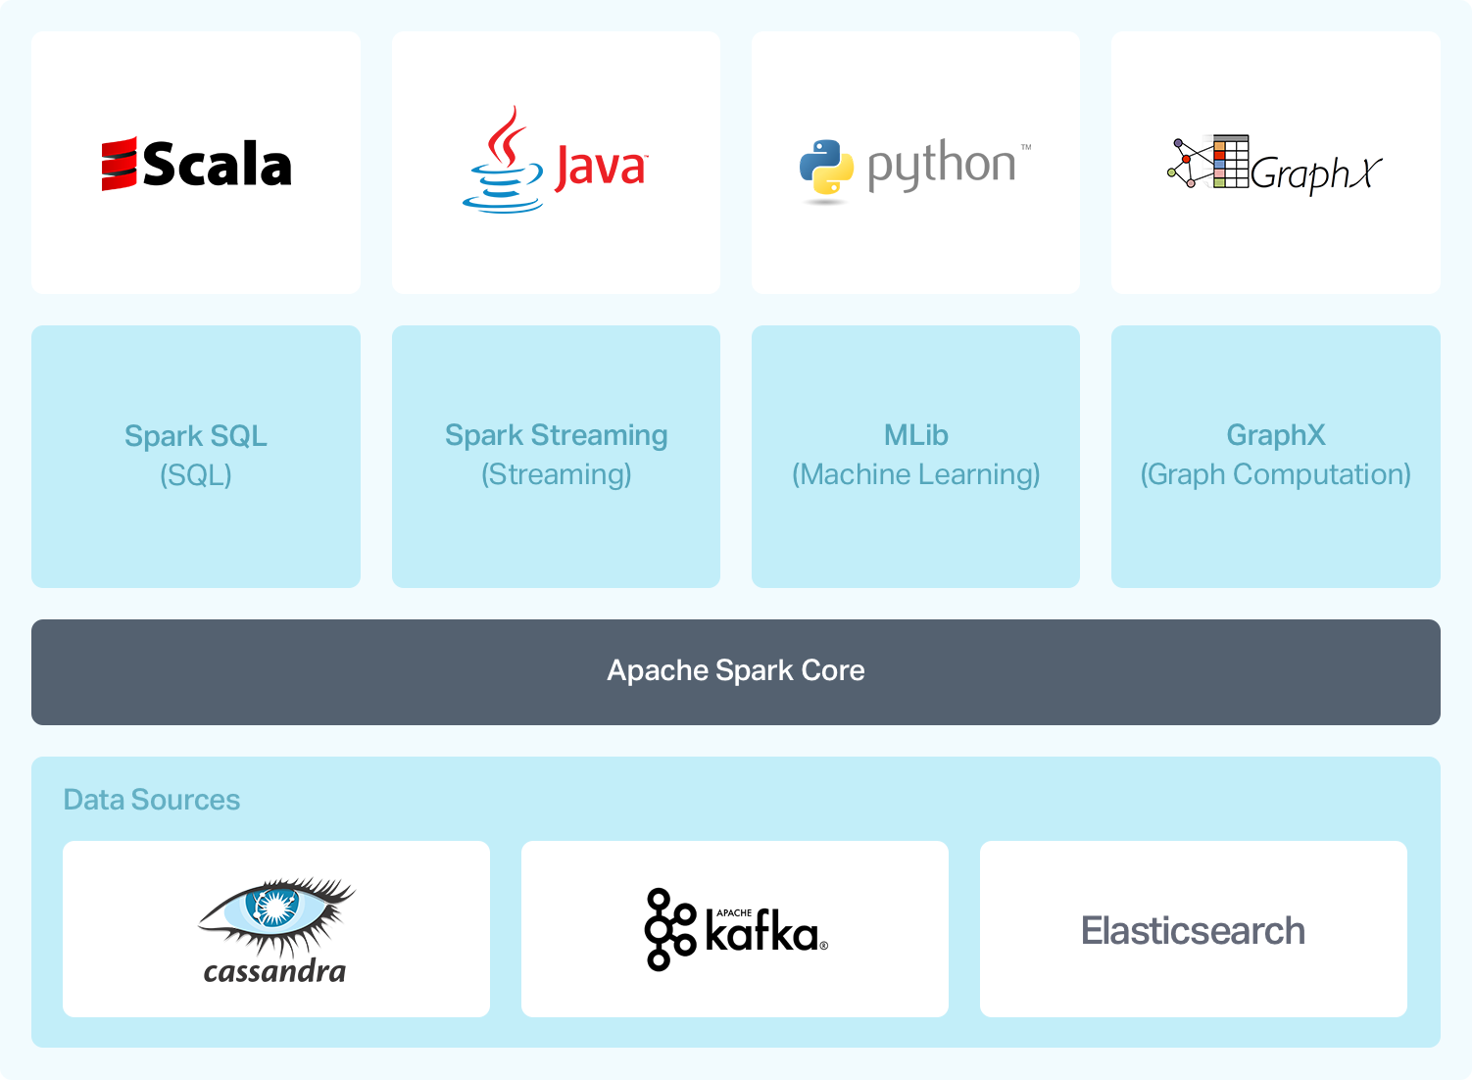
What is Spark?
Open-source distributed general-purpose cluster-computing framework
Unified analytics engine for big data processing, with built-in modules for streaming, SQL, machine learning and graph processing.
Provides an interface for programming entire clusters with implicit data parallelism and fault tolerance.
Notes:
https://www.instaclustr.com/apache-spark/#apache-spark-ecosystem

Slide 4

Key difference between MapReduce and Spark
Processing: Spark can do it in-memory, while Hadoop MapReduce has to read from and write to a disk.
As a result, the speed of processing differs significantly – Spark may be up to 100 times faster. However, the volume of data processed also differs: Hadoop MapReduce is able to work with far larger data sets than Spark.

Slide 5
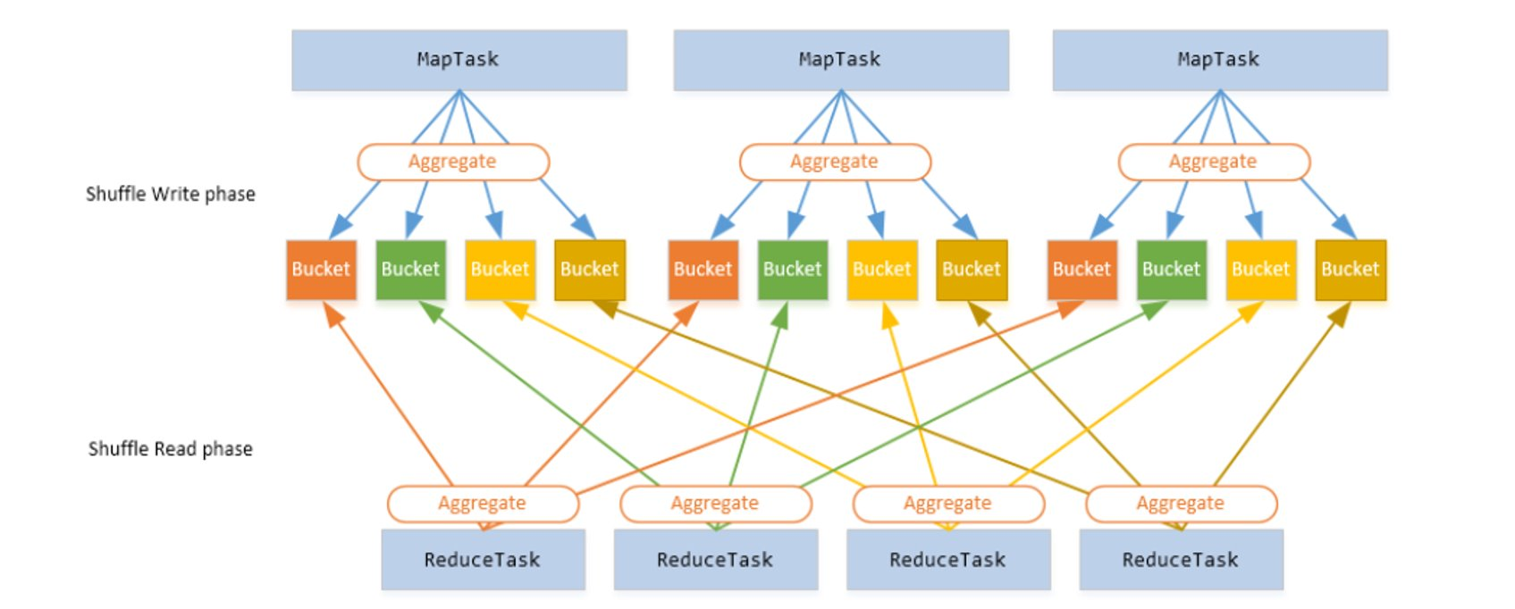
How does Spark work?

Slide 6
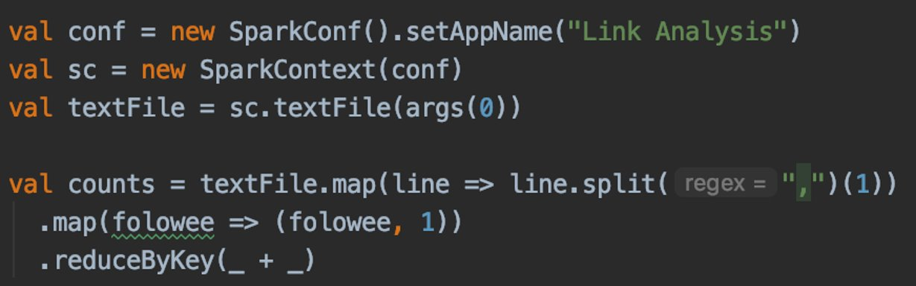
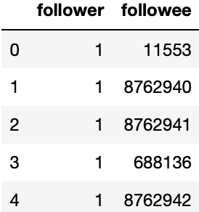
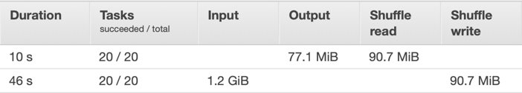
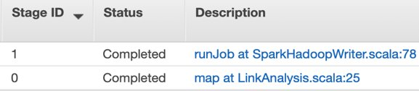
Demo

Slide 7
Current Issues
All-to-all communication required between map and reduce.
Wait time of reduce phase.
The number of disk I/o operations done by the reduce phase equals the number of map outputs generated.

Slide 8
Observations
Waste of time to wait by reduce phase.
Reduce will now access these merge outputs, which can decrease the number of I/o operations.
One can merge fragmented intermediate shuffle files into larger block files, and thus convert small, random disk I/O requests into large, sequential ones.

Slide 9
Riffle
Riffle is the shuffle merge service that keeps track of intermediate shuffle files and dynamically coordinates merge Operations.
Keeps track of task execution progress and schedules merge operations based on configurable strategies and policies.
The intermediate files are soon garbage collected after job completion, so they occupy disk space only temporarily

Slide 10
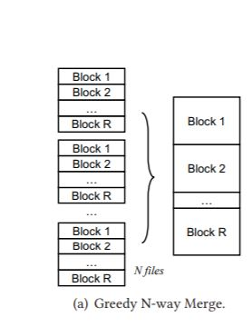
Merge with fixed Number of file
Notes:
In this statergy, files are merged whenver there are N map output files are available.
Merger will read exsisting shuffle output files and generating a new pair of shuffle output file

Slide 11
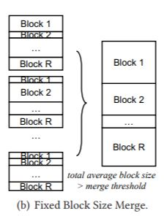
Merge with fixed block size
Notes:
In real-world settings, it is observed that a large variance in block sizes of the shuffle output files
Some shuffle blocks themselves are large enough, leading to few fragmented reads; some are very tiny
In this statergy, blocks are merged when the average shuffle block size across all partitions exceeds a configurable threshold. The Riffle scheduler avoids merging files that already have large blocks, and merges more files with tiny blocks for better I/O efficiency

Slide 12
Next Sprint Goals
Understand existing spark code
Research on ways to implement the N-Way merge
Find the appropriate data set
Start implementing the N-Way merge algorithm
Notes:
Understand existing spark code for the shuffle phase
Appropriate data set will be large enough that will fill up the memory, that will cause the data spillage, and hence causes IO operations

Slide 13

Thank You!
Any Questions?

